Slide 1
Welcome to Bumblebee Class.
Mrs Oliver – Teacher
Miss Robertson – T.A.
Miss McElroy – TA
Win –Midday Supervisor

Slide 2
Our Day
Toast
English/Maths
Choosing time which will involve outside and inside choosing alongside table work.
Playtime
Phonics
Lunchtime
Communication time (Attention Autism, What’s In the Box? Dough Disco)
Topic
Snack
Home time Preparation

Slide 3
Our Curriculum
We follow the Early Years Curriculum/National Curriculum.
We also follow the Engagement Model with some children. This has 5 elements
exploration.
realisation.
anticipation.
persistence.
initiation

Slide 4
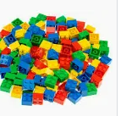
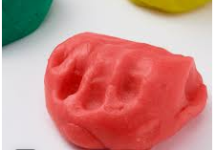
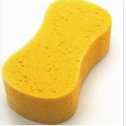
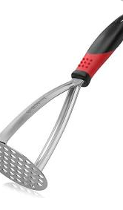
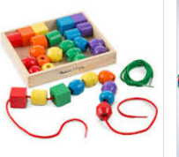
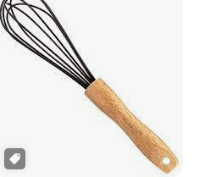
Pre-Writing
Lots of finger play and hand strengthening.

Slide 5
Mark Making
We will begin to encourage mark making throughout the day. This can be through paint, water, chalks etc.
Children will begin to make a series of marks before forming letters and sounds and we will work on these daily.

Slide 6
Reading
Reading to the children
Children looking at a book/picture with us. If they can they can tell their own stories about what is happening.
Asking lots of questions about the pictures to encourage their understanding. Use of communication boards to support children with symbols.

Slide 7
Maths
Numbers (saying and recognising) and counting. This will include objects from a big group, objects that can and cannot be moved.
Size length and weight
Shapes both 2d and 3d shapes
Coins
As the year progresses we will move to adding and subtraction

Slide 8
Lunches
Children choose their lunch daily.
The lunches are brought to the classroom and the teachers sit with the children whilst they eat.
Miss McElroy takes the children out with a Lunchtime Supervisor for playtime after lunch.
Please supply a water bottle each day for your child.

Slide 9
Forest School
This will take place up until October half term.
Encourages child led learning and exploration.

Slide 10
Please feel free to look around the classroom and outdoor classroom and ask any questions.

