Slide 1
Welcome to Poppy Class 23-24

Slide 2
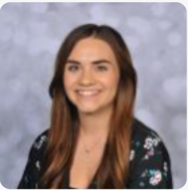
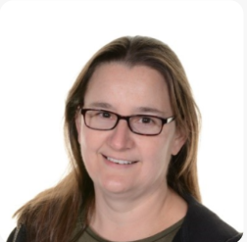
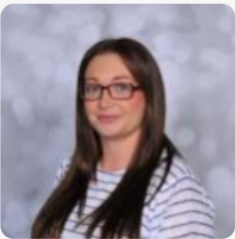
Introductions…
Miss Collins
Mrs Lothrop
Miss Gregory

Slide 3
Poppy Class is a KS2 class made up of year 4 and year 5 pupils.

Slide 4
On arrival…
Toast, juice and water are available on arrival for the children to enjoy! Snack at the end of the day is also offered for children to have!
Pupils can bring a bottle to leave in school, however we do have cups.
A contribution of £1.50 per week towards toast is received with thanks to school and a 50p contribution for snack is appreciated as school do not fund this.

Slide 5
Forest School
Mrs Lothrop runs Forest School sessions. We are taking part in Forest School in this first half term. We have Forest School every Tuesday morning and we ask if the children can bring suitable clothes and wellies.

Slide 6
PE
PE is on a Monday morning and delivered by Warrington Wolves.

Slide 7
Equipment
All equipment is provided by school. Pupils each have access to equipment within the classroom.

Slide 8
What should pupils bring to school daily?
Pupils have all been given a home-school diary.
These are used for school/home communication. Please feel free to write any notes to class staff in here. Staff will also use the diary to pass on any messages home, please check these daily.
Reading books and records are given in line with pupils phonics assessments. We aim to read with your child on a 1:1 basis 3x each week. Please record in the reading record when you have read with your child at home.
Books will be changed as required.
Water bottles.

Slide 9
Any questions?

Slide 10
Thank you for taking the time to join us this afternoon! As always your support is much appreciated.

