Slide 1
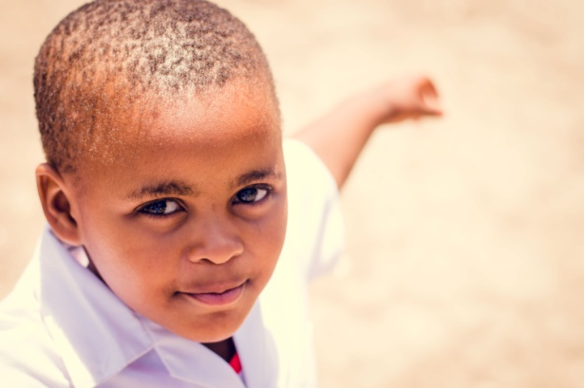
South Africa Schools Fund
Making a difference

Slide 2
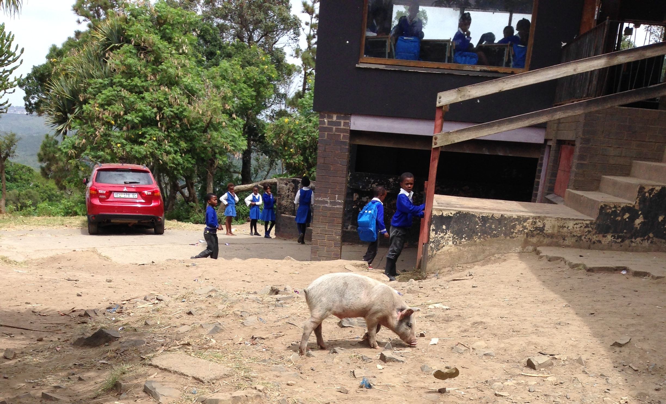

Slide 3
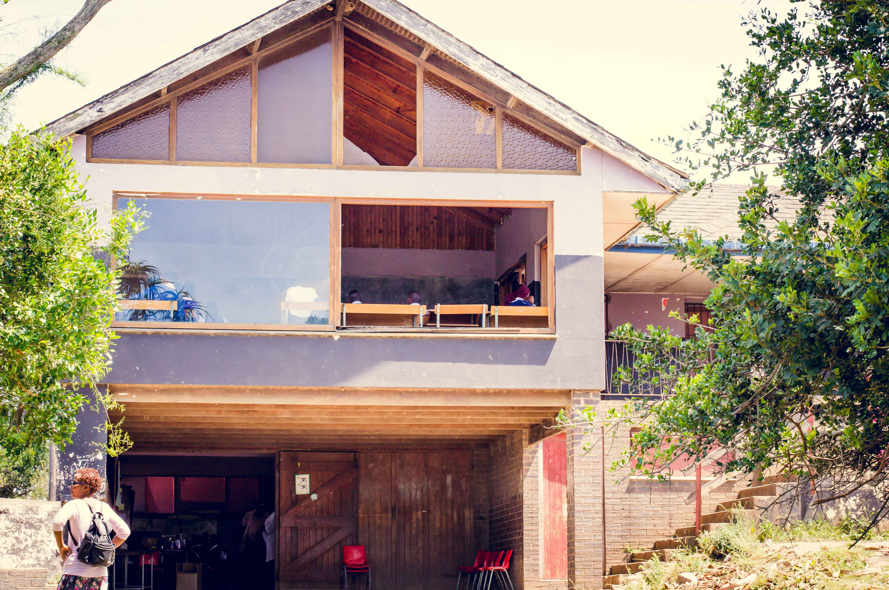

Slide 4
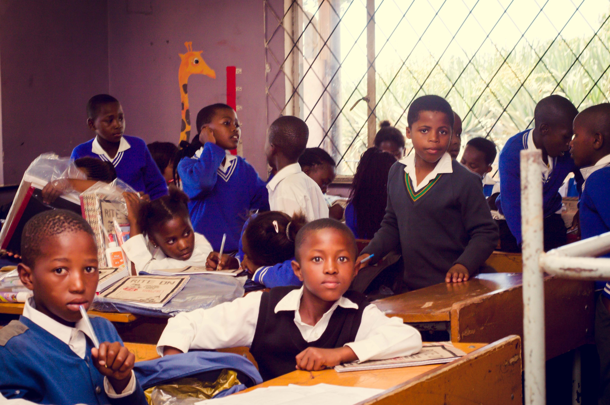

Slide 5
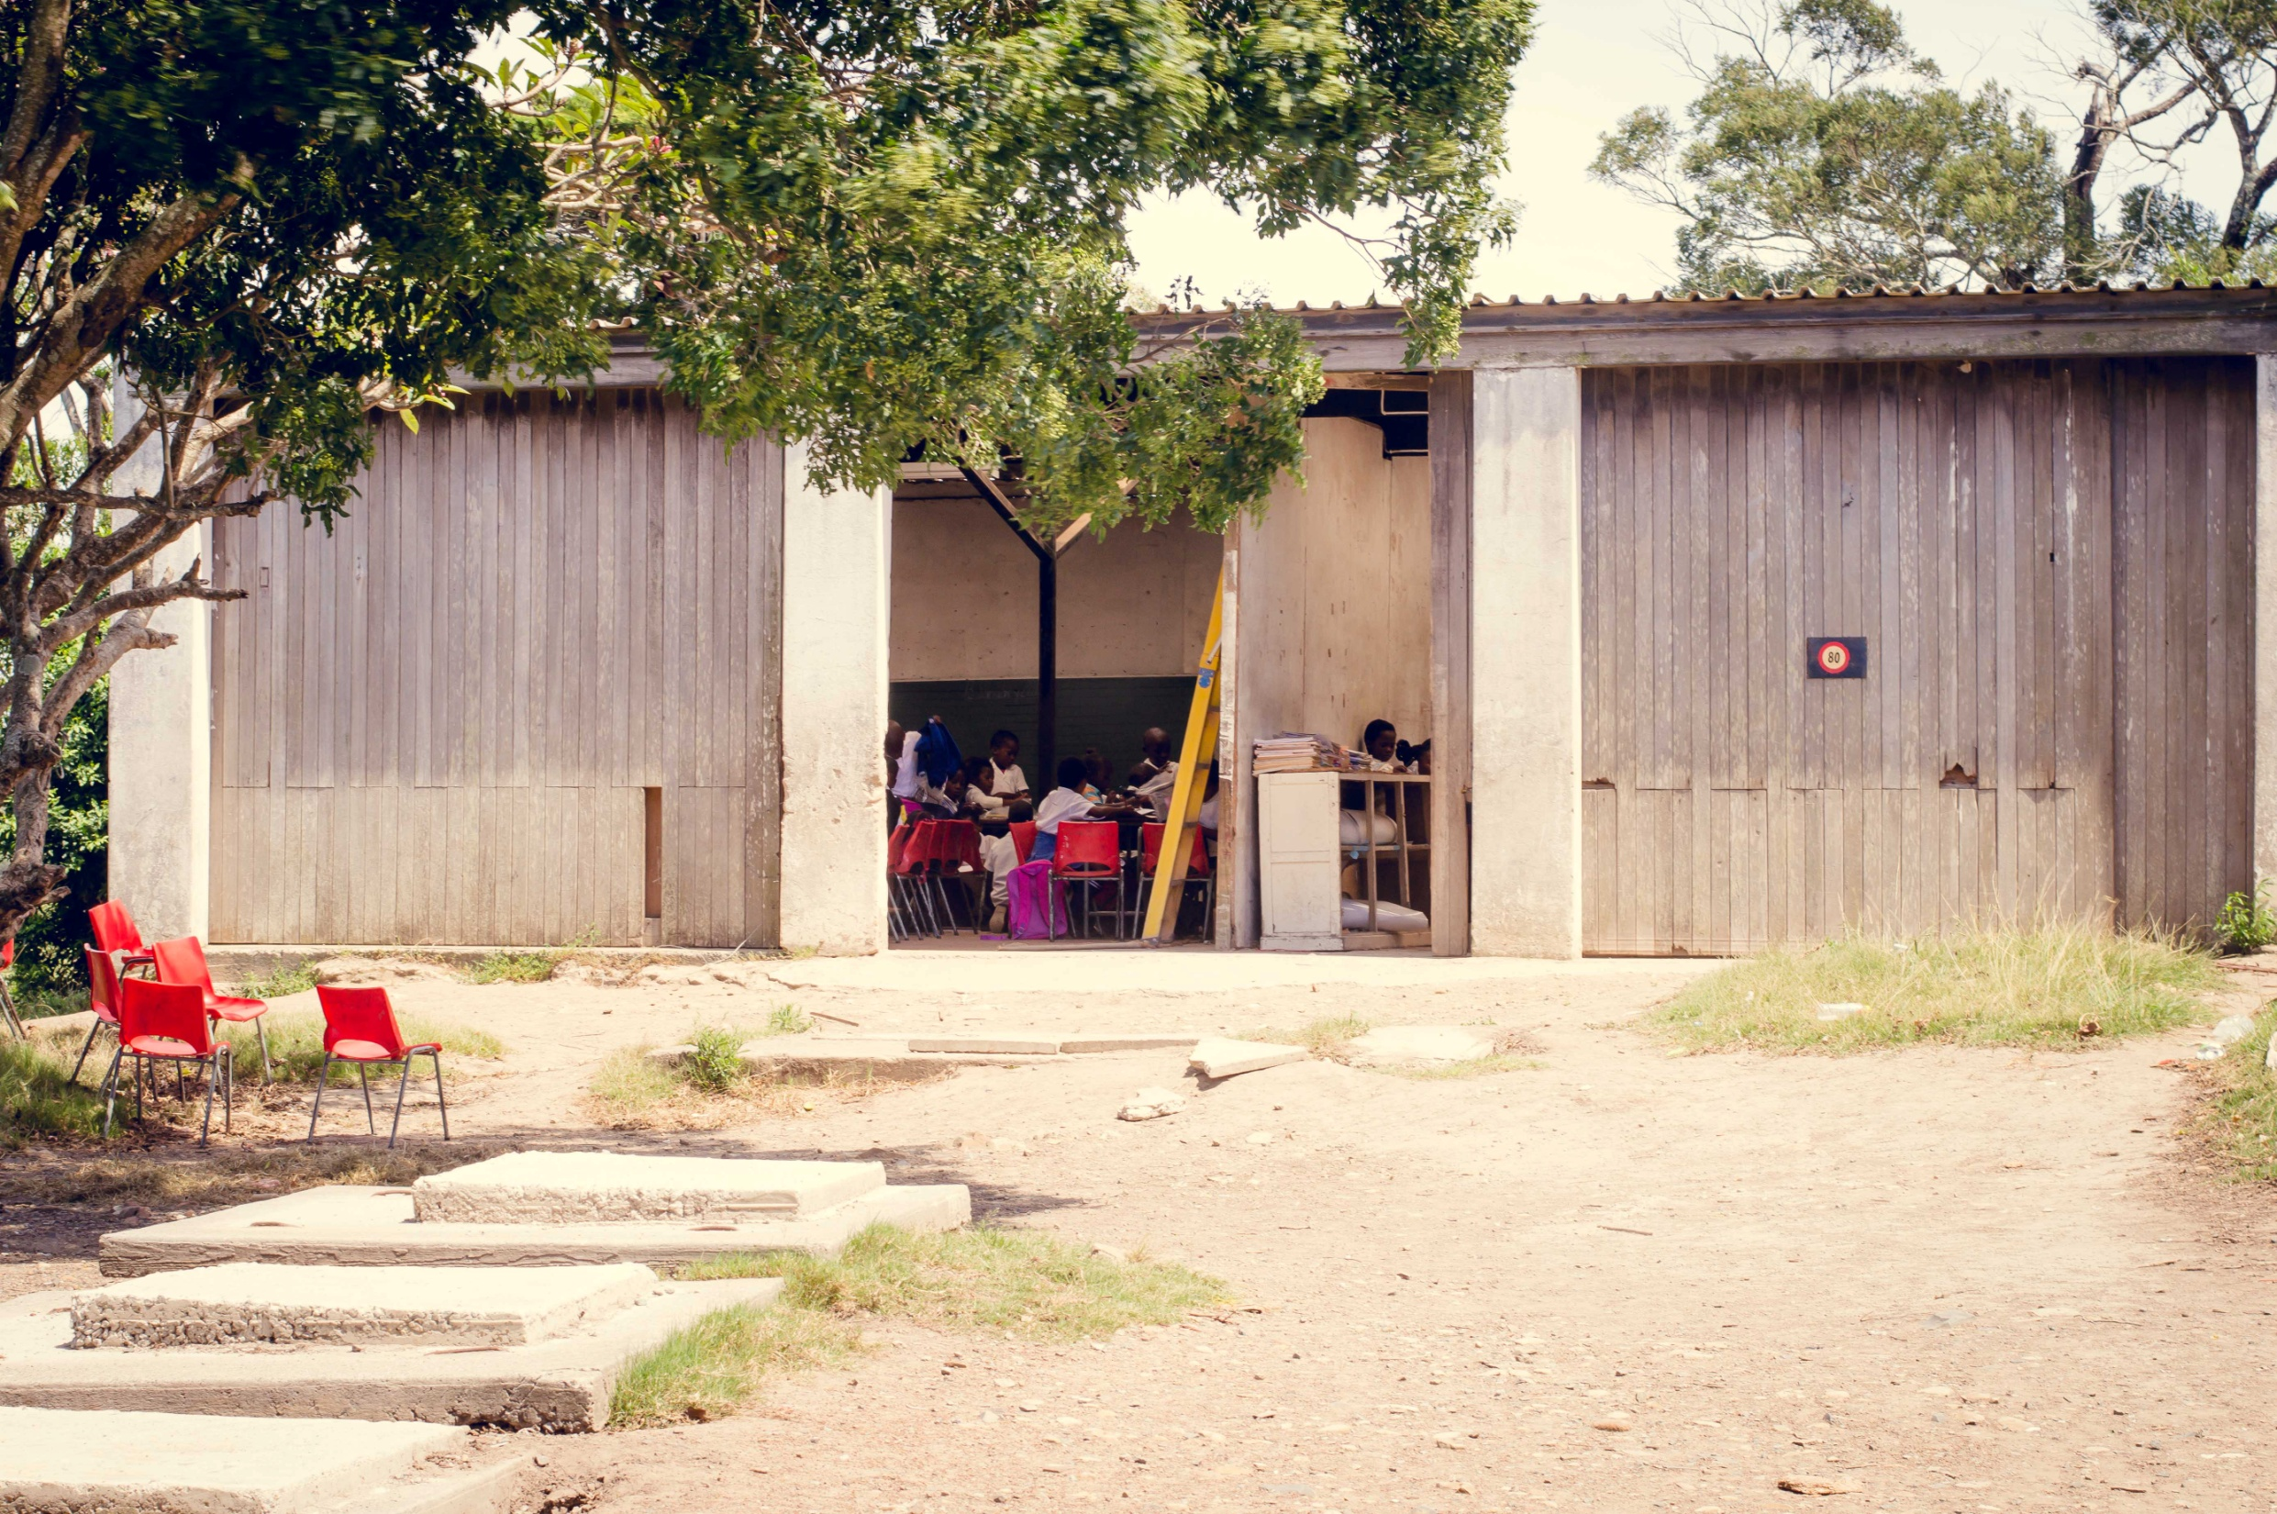

Slide 6
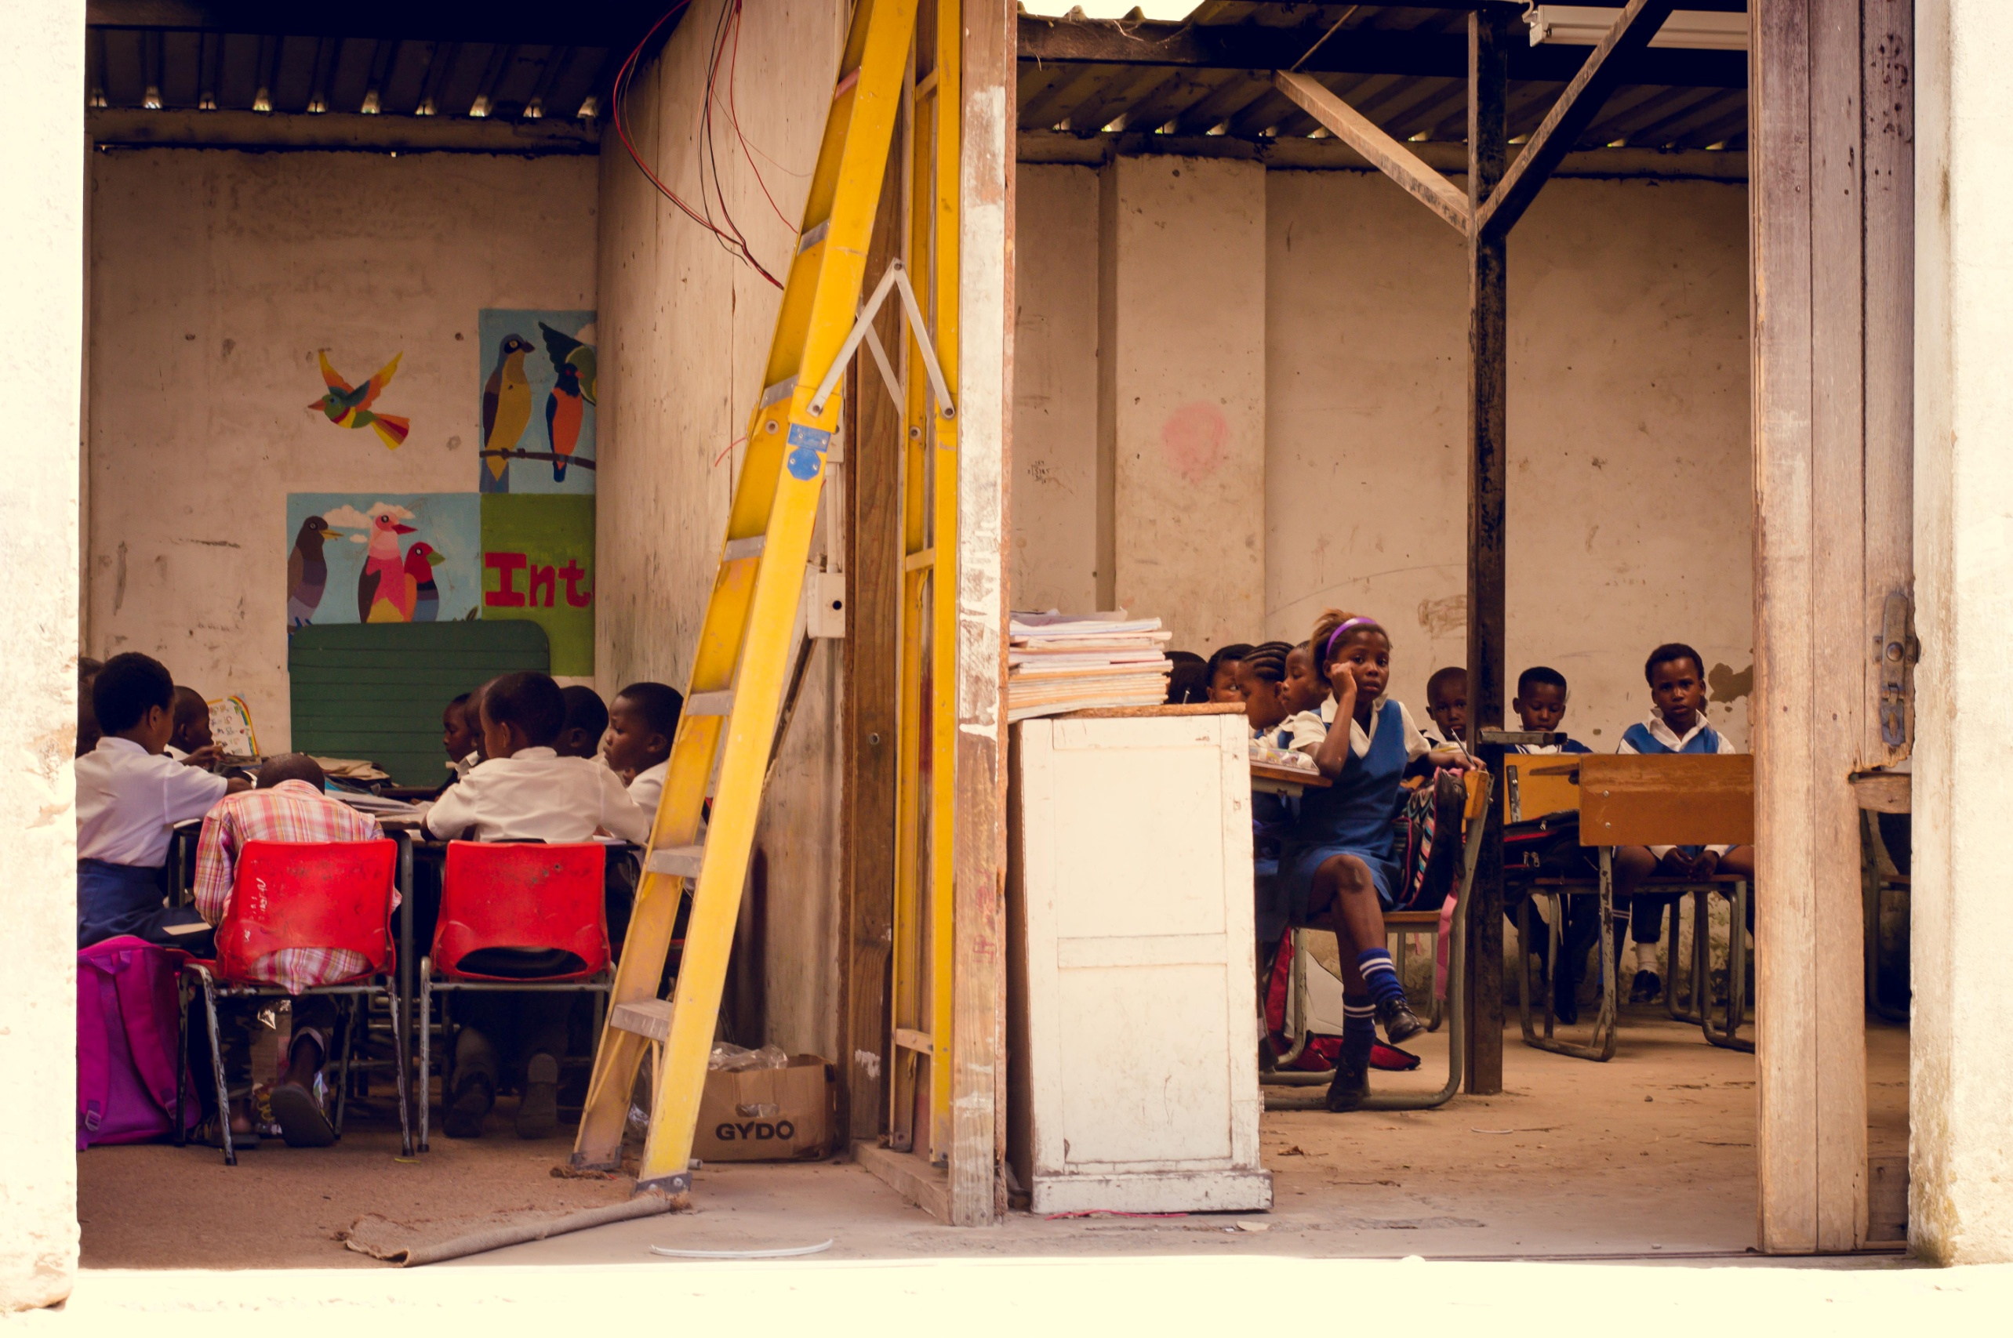

Slide 8
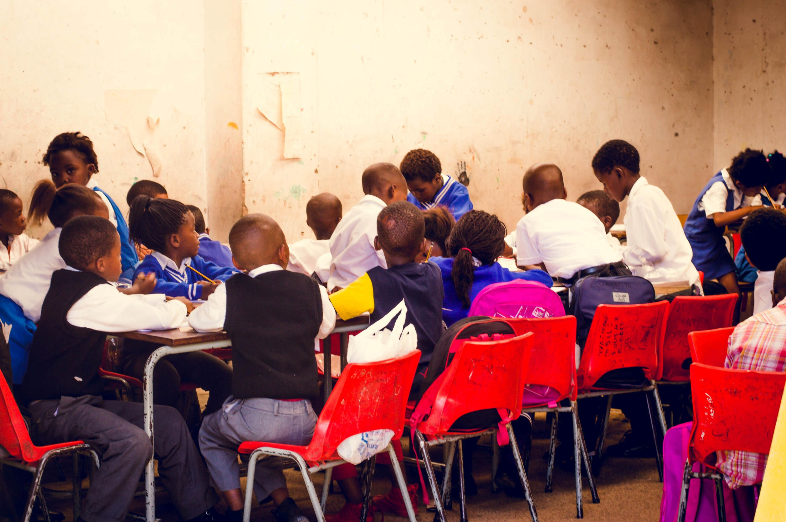

Slide 9
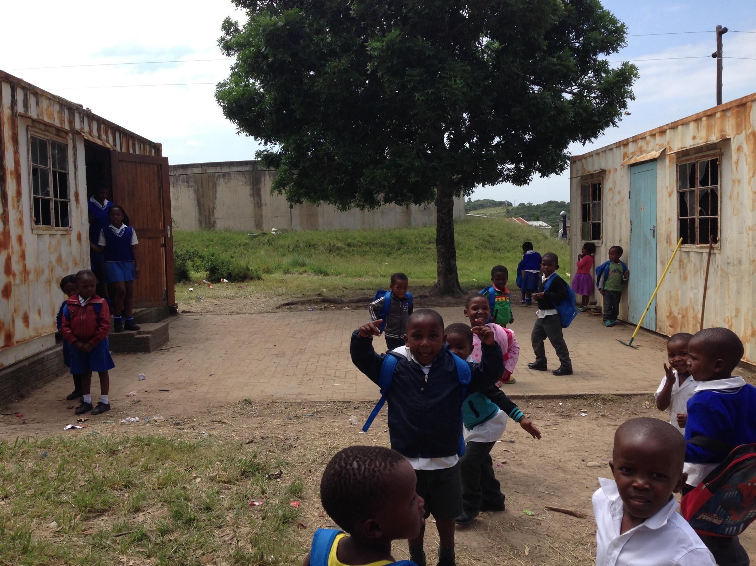

Slide 10
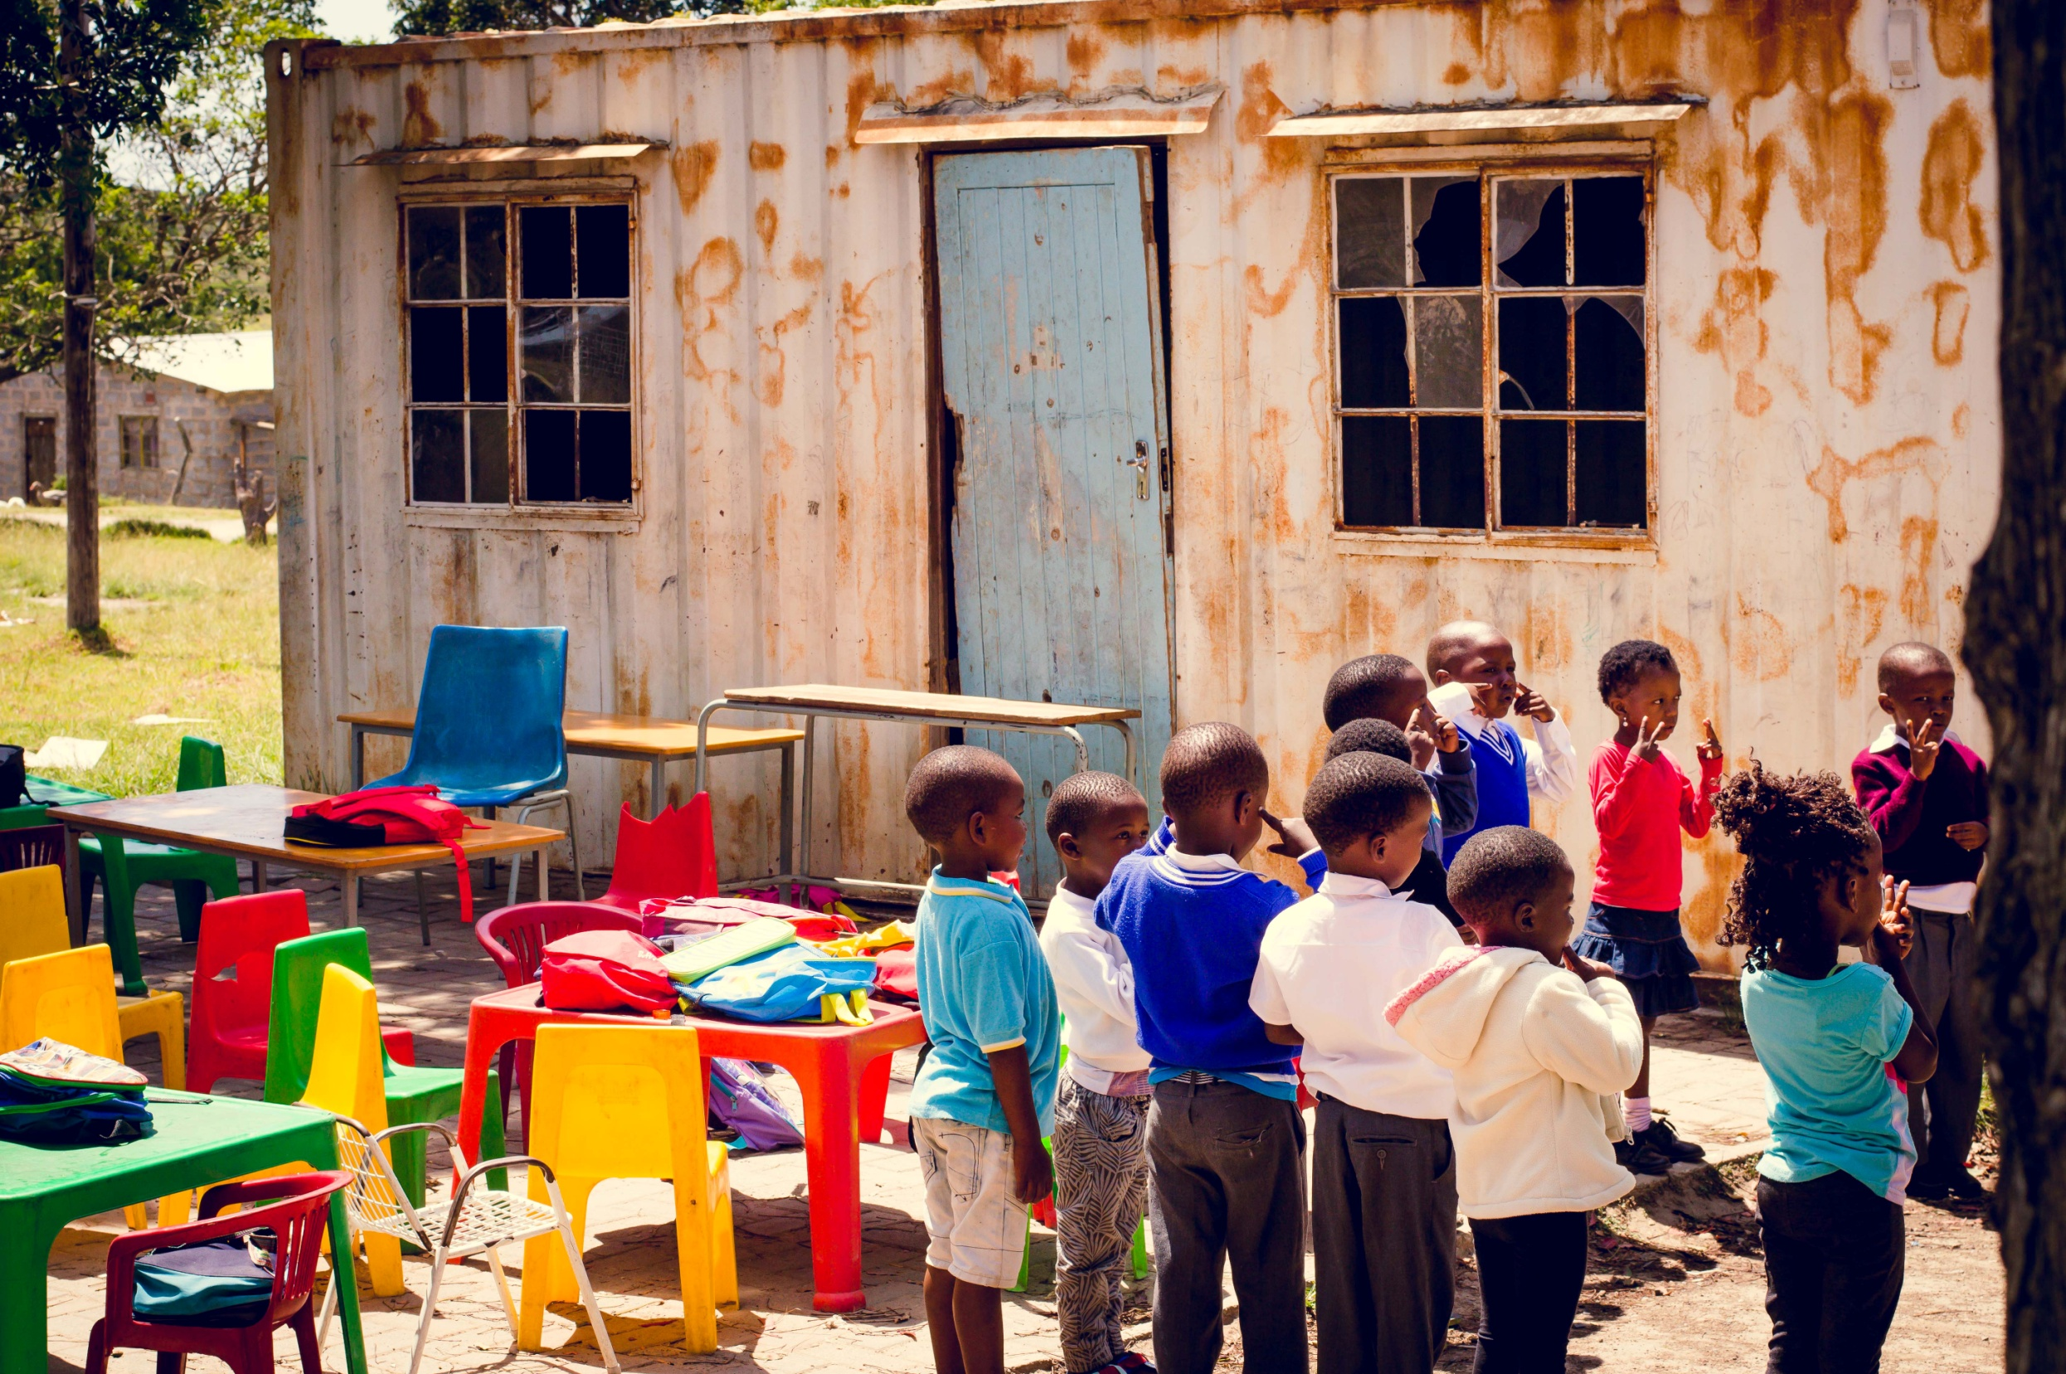

Slide 11
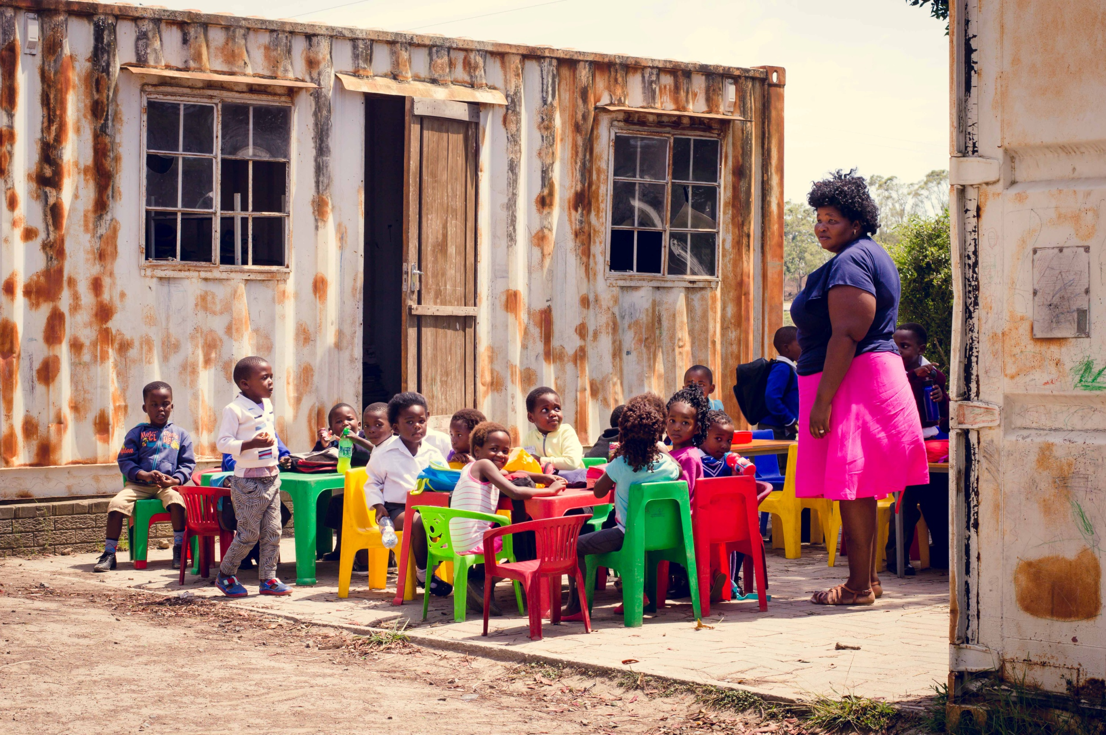

Slide 12
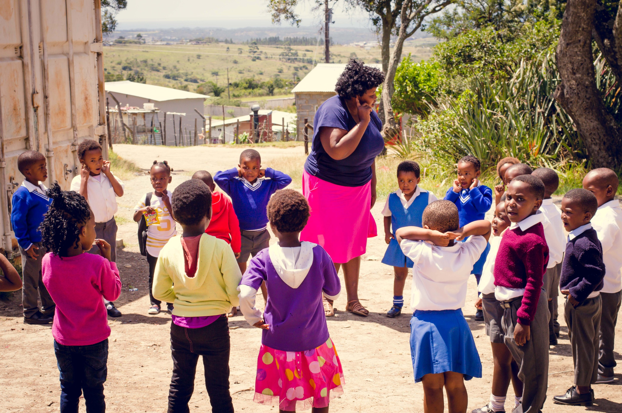

Slide 13
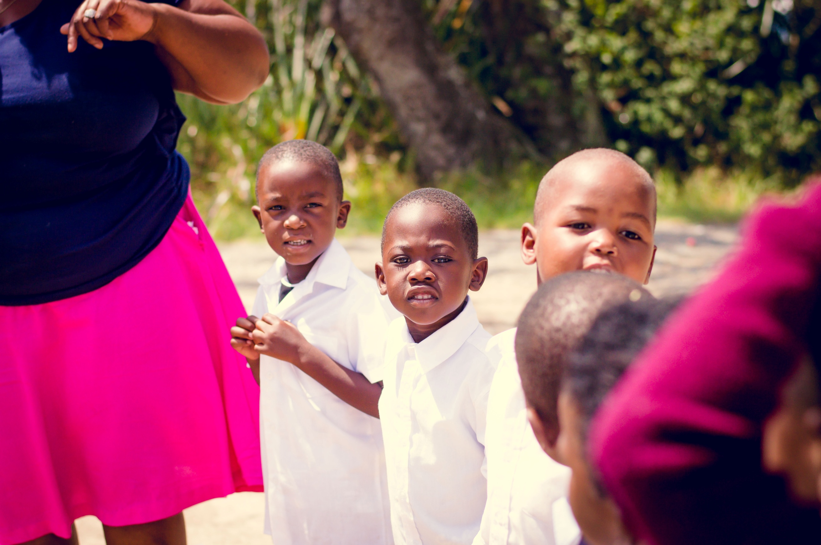

Slide 14
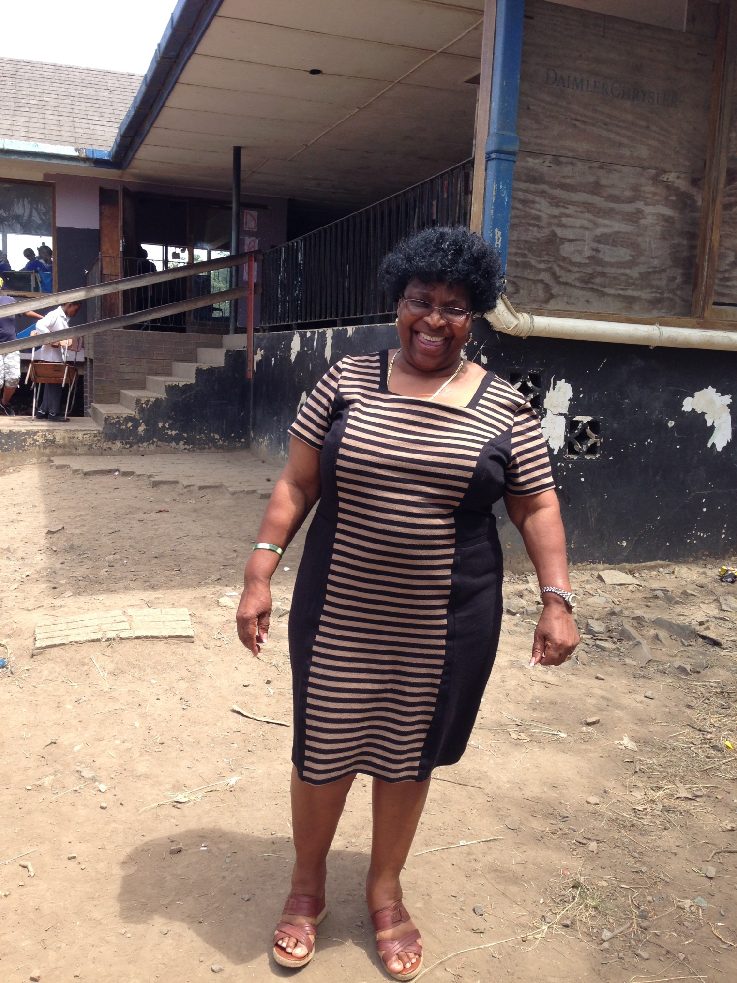
OH GOD IS GREAT, OUR CLASSES ARE BRIGHT, THE LIGHTS ARE ON!
IT’S LIKE A DREAM TO ME, THE TEACHERS AND THE LEARNERS.
OH, I DON’T KNOW WHAT I CAN SAY BUT A BIG THANK YOU, WHAT
A WONDERFUL WORK THE CHURCH IS ALWAYS DOING FOR OUR SCHOOL.

Slide 15
In the words of a pupil:
We as learners at Noncedo school want to thank you for all you have done for us and we really appreciate what you have done for us and it really means a lot to us. Thank you very much. May God bless you.
From all of us

Slide 16
Thank you for your interest and support
Every pound makes a difference

Slide 17
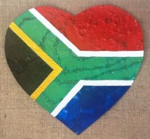
Coffee Afternoon
Friday 12 February 1.30-3 p.m.
Woolston Sixth Form common room
Join us for
delicious Valentine’s cakes and a hot or cold drink
Buy a gift for your Valentine or someone you love - Fudge, Chocolates, Flowers, Love Tokens, Books and More
In support of the South Africa School Fund
Bringing electricity to classrooms and warm jackets for winter

