Slide 1
Welcome to Grasshopper Class

Slide 2
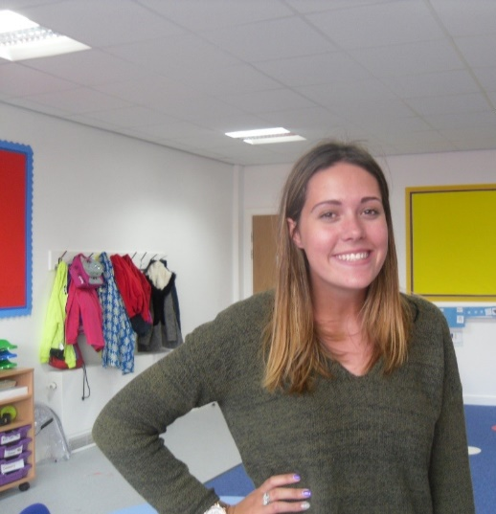
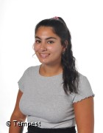
Introductions…
Miss Barnes
Mrs Golden
Miss Virdi

Slide 3
Grasshopper class
A mix of reception and year one pupils.
All pupils have a diagnosis of autism and will follow our autism pathway across school.
Follow the early years curriculum- communication & language, physical development, PSED, understanding the world, expressive arts and design, literacy and mathematics
Structure and zones- visual timetable, zoned areas, outdoor and indoor continuous provision.
Sensory circuit and sensory room
Trips out into the community
Snack- PECS

Slide 4
On arrival…
Pupils will take off their coats and bags and go to their timetable.
Low arousal environment and sensory circuit.
Toast.

Slide 5
What should pupils bring to school daily?
Home school book
Coat
PE Kit- stay in school and go home each term
Reading books and records will start to go home next week
Buddy the Bear- weekly
Lunch box, snack, snack money, water bottles.

Slide 6
SHINE (Lisa and Sophie)
Parent talks
OT reports
Sensory supports
Restrictive eating

Slide 7
SALT

Slide 8
SCERTS
Social Communication
Emotional Regulation
Transactional Supports
Curriculum
Targets
SCERTS clinics
EFL

Slide 9
SCERTS Parents groups
Working together with your children in the school environment and out in the community.
Working with school to develop consistent approaches and strategies.
Common themes and challenges.
Talks with our OT
Emotional regulation advice
Heading to the local supermarket
Eating out in a restaurant

Slide 10
NAS Advanced School

Slide 11
EFL & Website
Please check EFL to see your child’s work and progress in school. You are more than welcome to pictures from home.
Please check the website for class information.
There is an autism section on the website in which we keep up to date.
Communication via home school book or class email.

Slide 12
Any questions?

